Slide 1
Educator Effectiveness Funding 2021-26 Allowable Expenses
Coaching and mentoring of staff with focus on retaining teachers and offering structured feedback and coaching systems organized around social-emotional learning
Programs that lead to effective instruction and improve instruction literacy across all subject areas
Practices and strategies that reengage pupils and lead to accelerated learning
Strategies to implement social-emotional learning, trauma-informed practices, suicide prevention, access to mental health services
Practices to create a positive school climate including prevention of discrimination, harassment, bullying, and intimidation
Strategies to improve inclusive practices including universal design for learning
Instruction to support implementing effective language acquisition programs for English learners
New professional learning networks for educators not already engaged in an education-related professional learning network, which may include integrated language development within and across content areas, and building and strengthening capacity to increase bilingual and bi-literate proficiency
Instruction, education, and strategies to incorporate ethnic studies curricula
Instruction, education, and strategies for certificated and classified educators in early childhood education, or childhood development

Slide 2
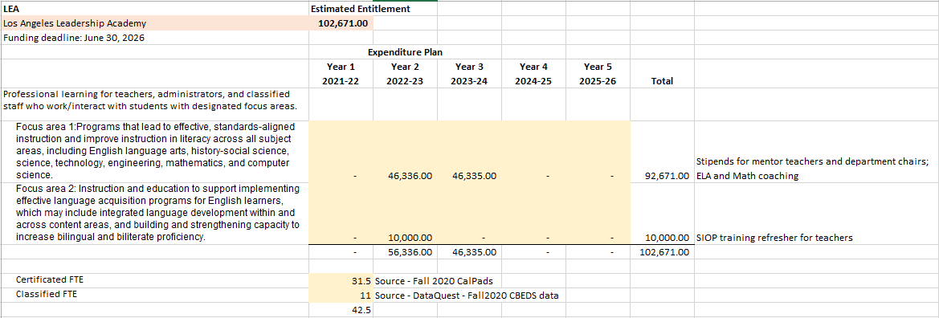
LALA

Slide 3
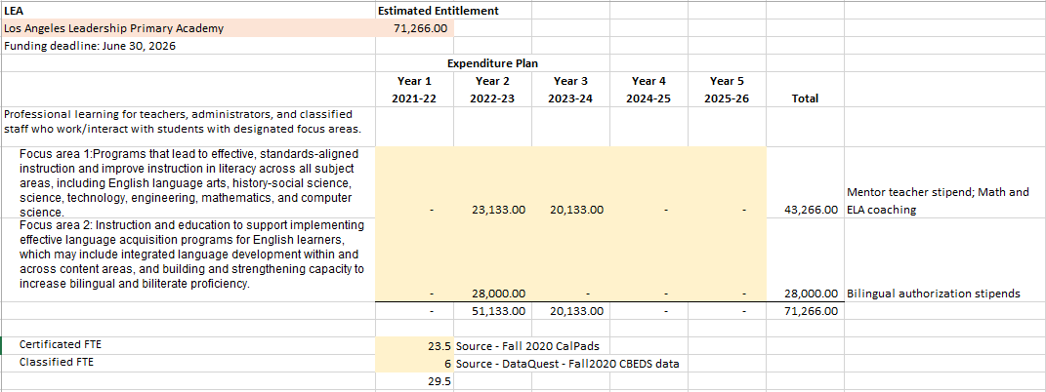
LALA Primary

